Slide 1
Meridian Public School District Bond
New Projects for
Magnolia & Northwest Middle Schools
& Senior High School

Slide 2
Meridian Senior High School

Slide 3
Bird’s Eye
Interior Courtyard

Slide 4
Meridian High School
New Administration
New Secure Entry
New Connector Hall
Band Hall Renovations
New Covered Paths

Slide 5
Floor Plans
1,975 Sqft of New Administration Space
2,050 Sqft of New Conditioned Corridor
300 Sqft Exterior Covered Porch

Slide 6
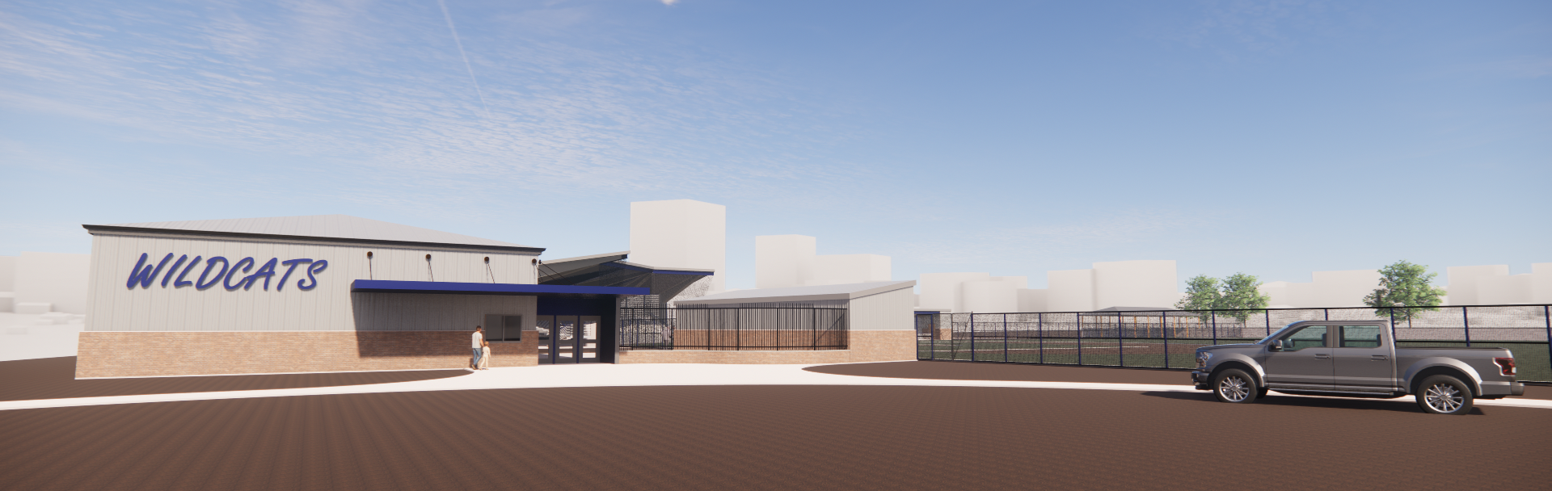
Meridian HS Athletics

Slide 7
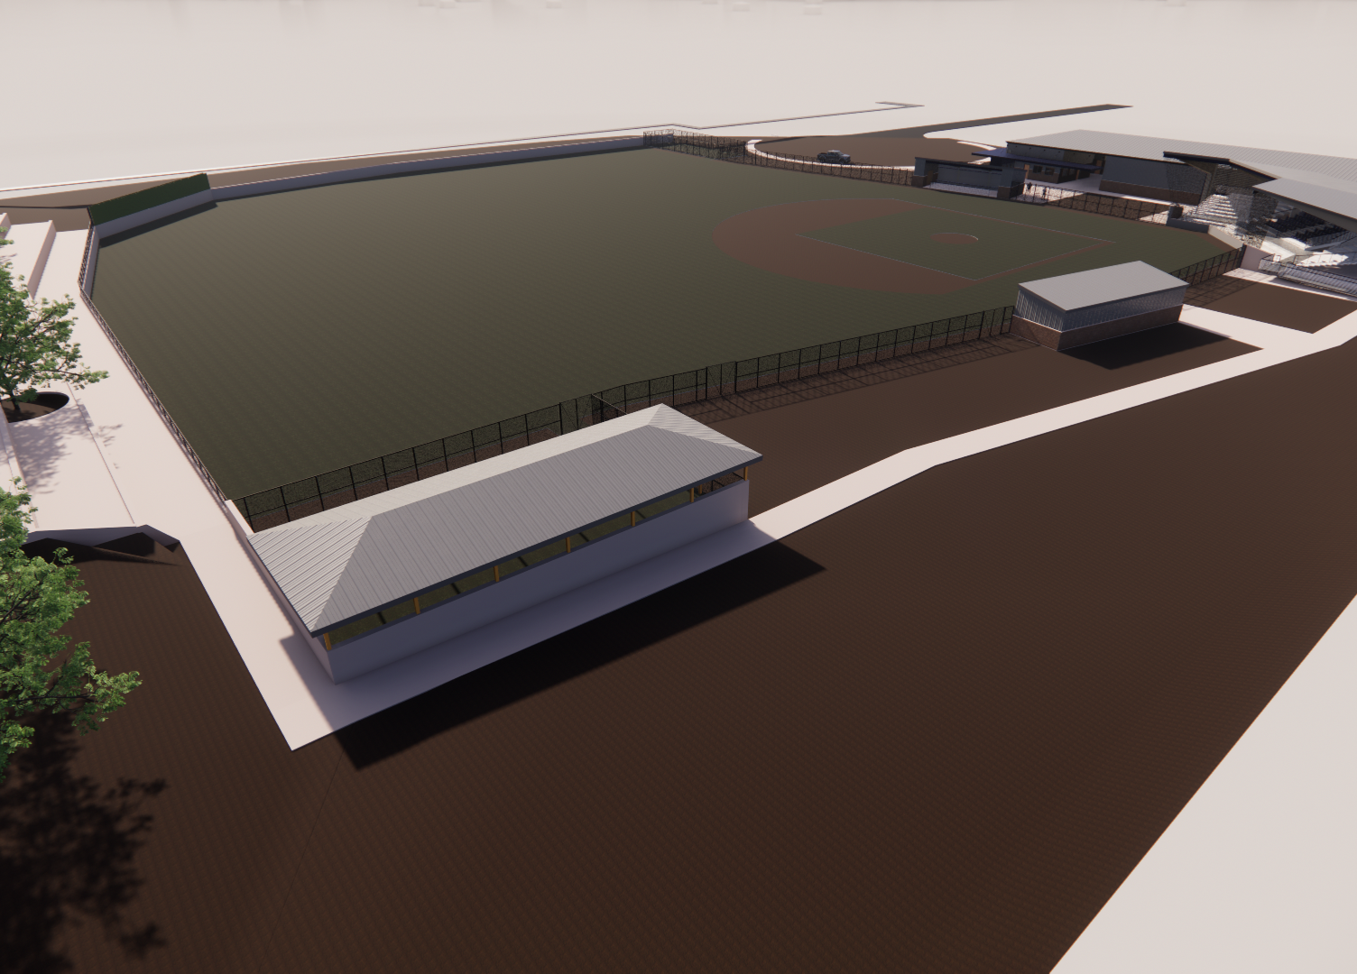
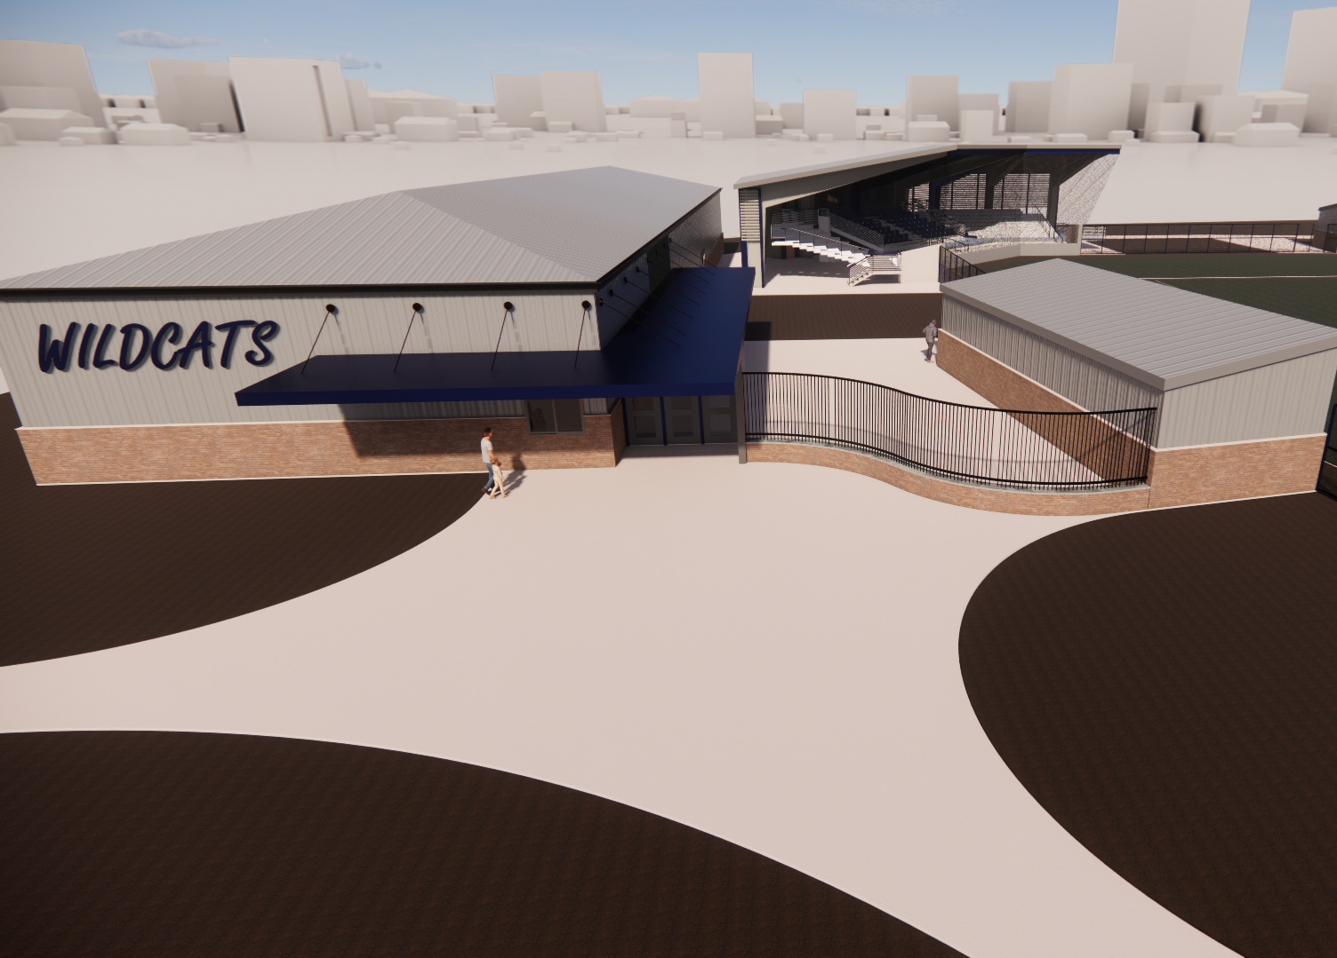
Bird’s Eye
Main Entry

Slide 8
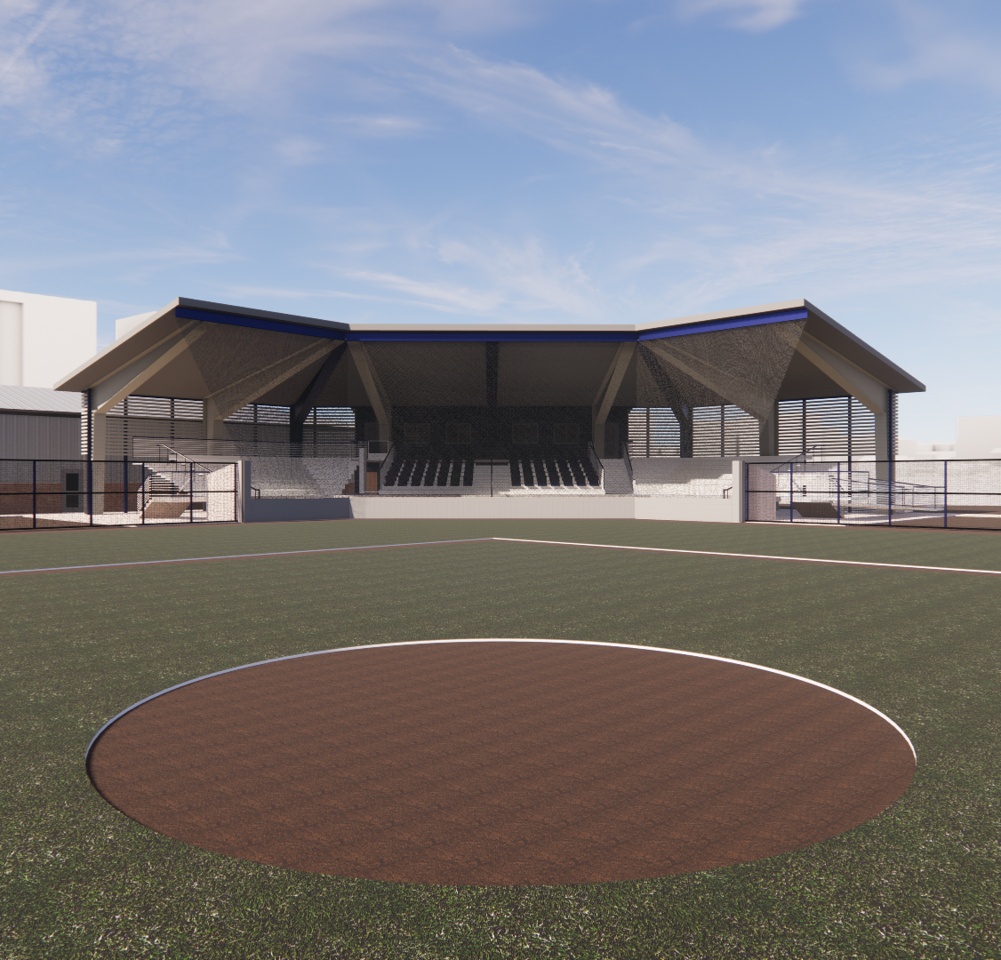
Meridian Athletics
New Entry/Concessions
New Field House with Training
New Turf Facility for Softball & Baseball
New Stadium with Press Box
New Left Field Lounge

Slide 9
Floor Plans
Full Turf Field
Removable Softball Fencing
Bull Pens
Dugouts
Covered Batting
Covered Stadium Seating
New Field House

Slide 10
Floor Plans
Tickets
Concessions
Training
Lockers
Laundry
Offices

Slide 11
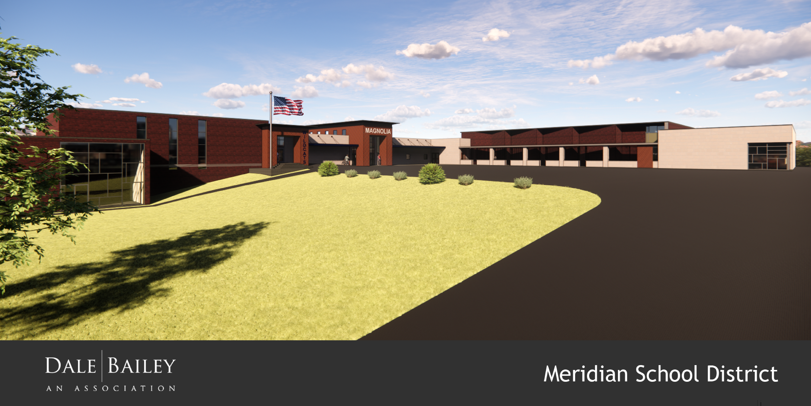
Magnolia Middle School

Slide 12
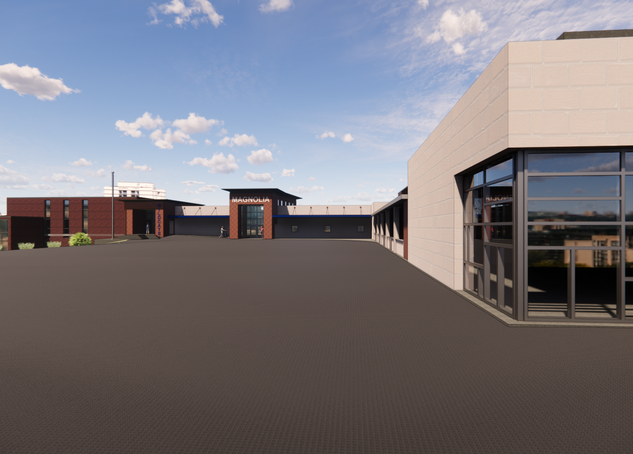
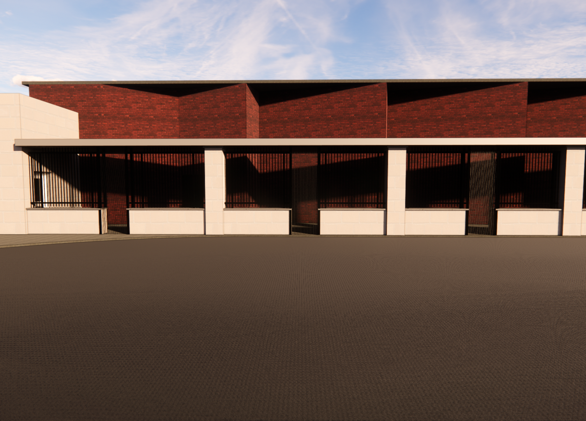
View from Parking
Secure Fencing

Slide 13
Magnolia Additions
New Entry/Lobby/Admin
New Concessions & Toilets
Media Center Addition
Cafeteria Expansion
Band/Chorus Addition
New Science Lab & Classrooms

Slide 14
Floor Plans
New Admin
New Secure Entry
New Concessions
New Toilets
New Science Lab
New Media Center
Renovated Counselor offices

Slide 15
Floor Plans
New Band
New Chorus
Enclosed Porch

Slide 16
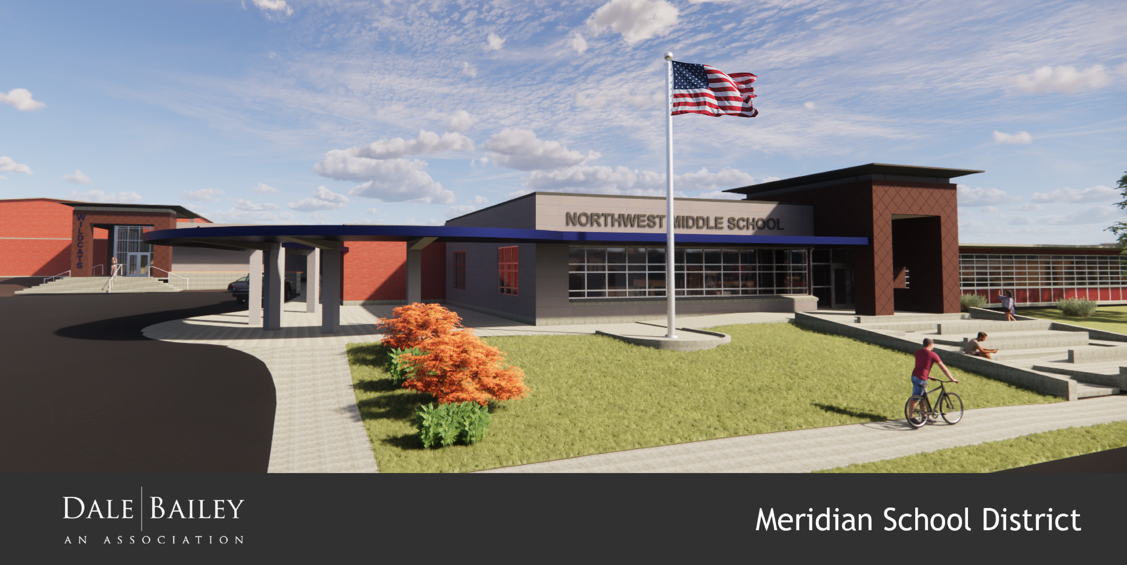
Northwest Middle School

Slide 17
Bird’s Eye SW
Bird’s Eye NE

Slide 18
Northwest Admin
New Entry/Lobby
New Admin Offices
New Media Center Storage and Office
Renovated Counselor Offices
New Covered Drop Off
New Grand Plaza at Front

Slide 19
Floor Plans
Admin Offices
New Reception
New Secure Entry
Renovated Work
Renovated Conference
New Media Storage
New media Office
Renovated Counselor

Slide 20
Gym Entry
New Entry/Lobby
New Concessions & Toilets
New Covered Drop Off

Slide 21
Class Room Addition
New Connector Hall
New Classrooms
New Ramps/Stairs to Upper Level
New Science Lab

Slide 22
Floor Plans
Classrooms
Science Lab
Concessions
Ramps
Stairs

Slide 23
Fine Arts Addition
New Entry/Lobby
Expanded Cafeteria
New Band Hall

Slide 24
Floor Plans
New Entry
Band Hall
Office & Storage
Expanded Cafeteria
New Look

Slide 25
Meridian Public SD Bond Issue
Meridian HS
Athletics
Magnolia Middle
Northwest Middle

