Slide 1
Meridian Public School District Bond
New Projects for
Magnolia & Northwest Middle Schools
& Meridian High School

Slide 2
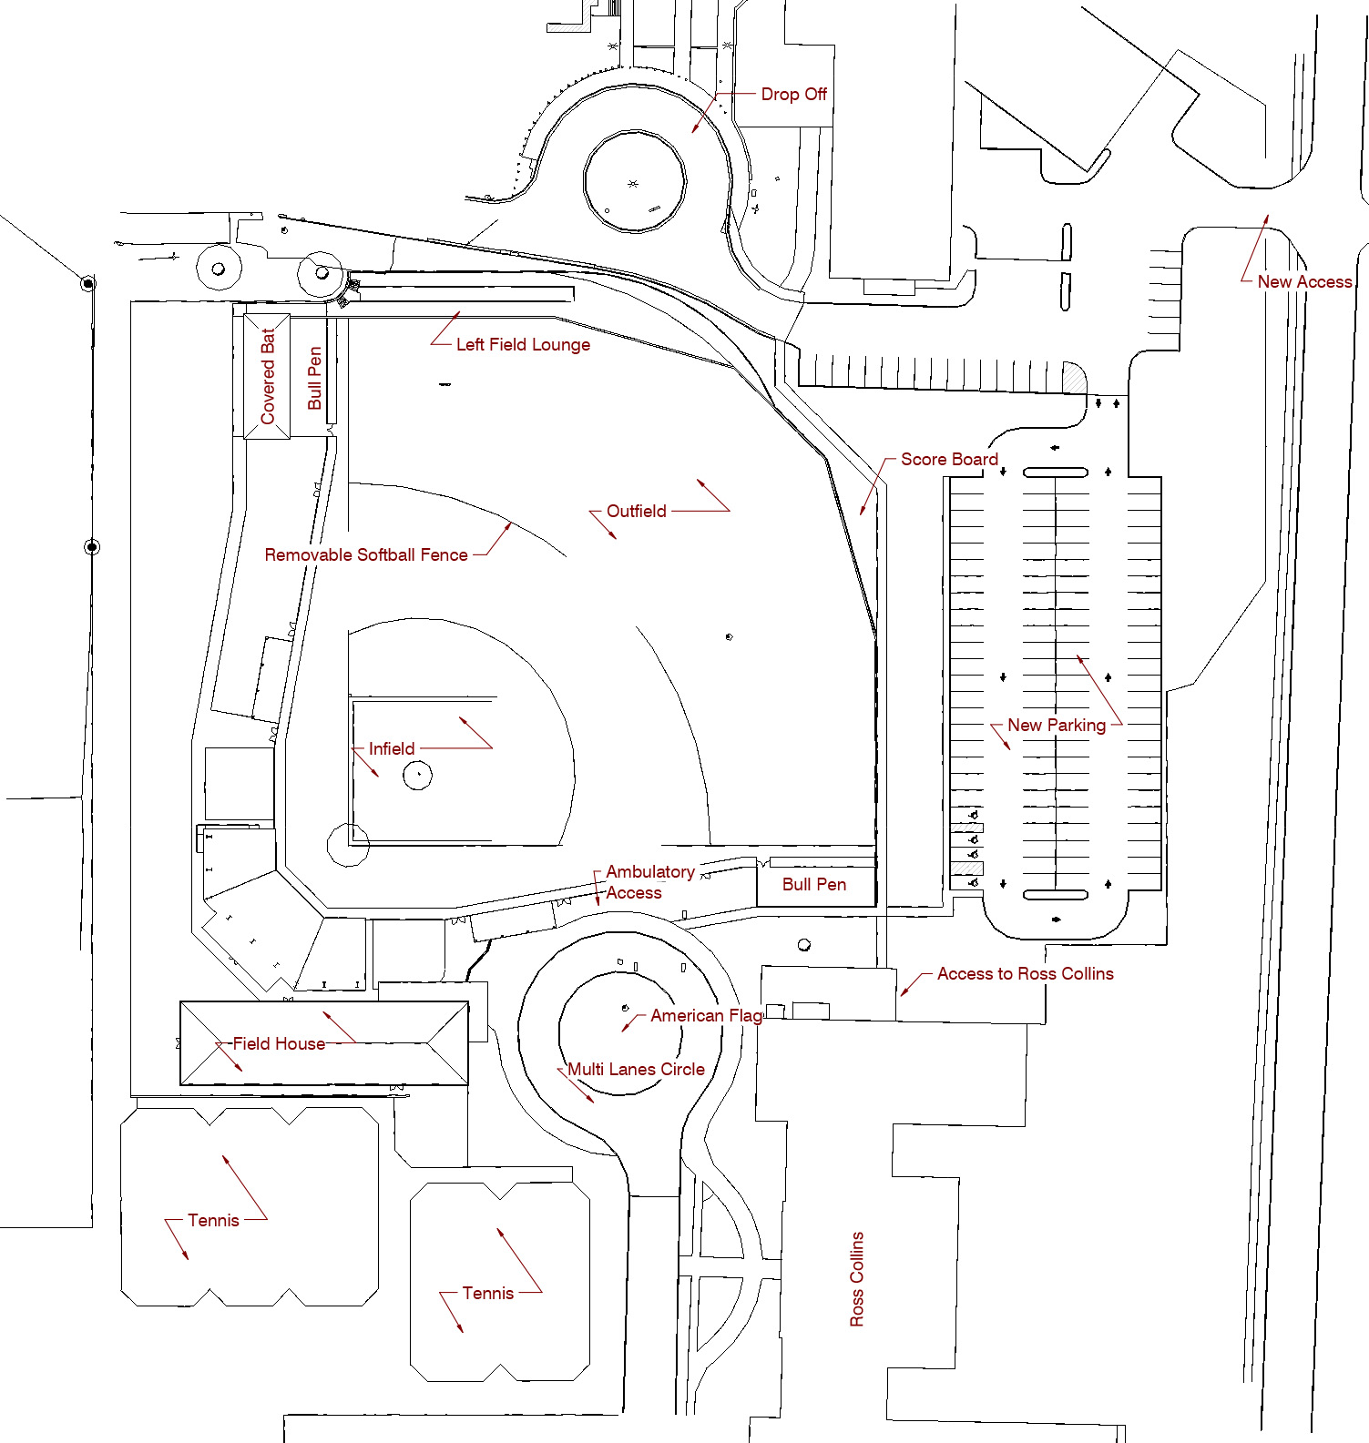
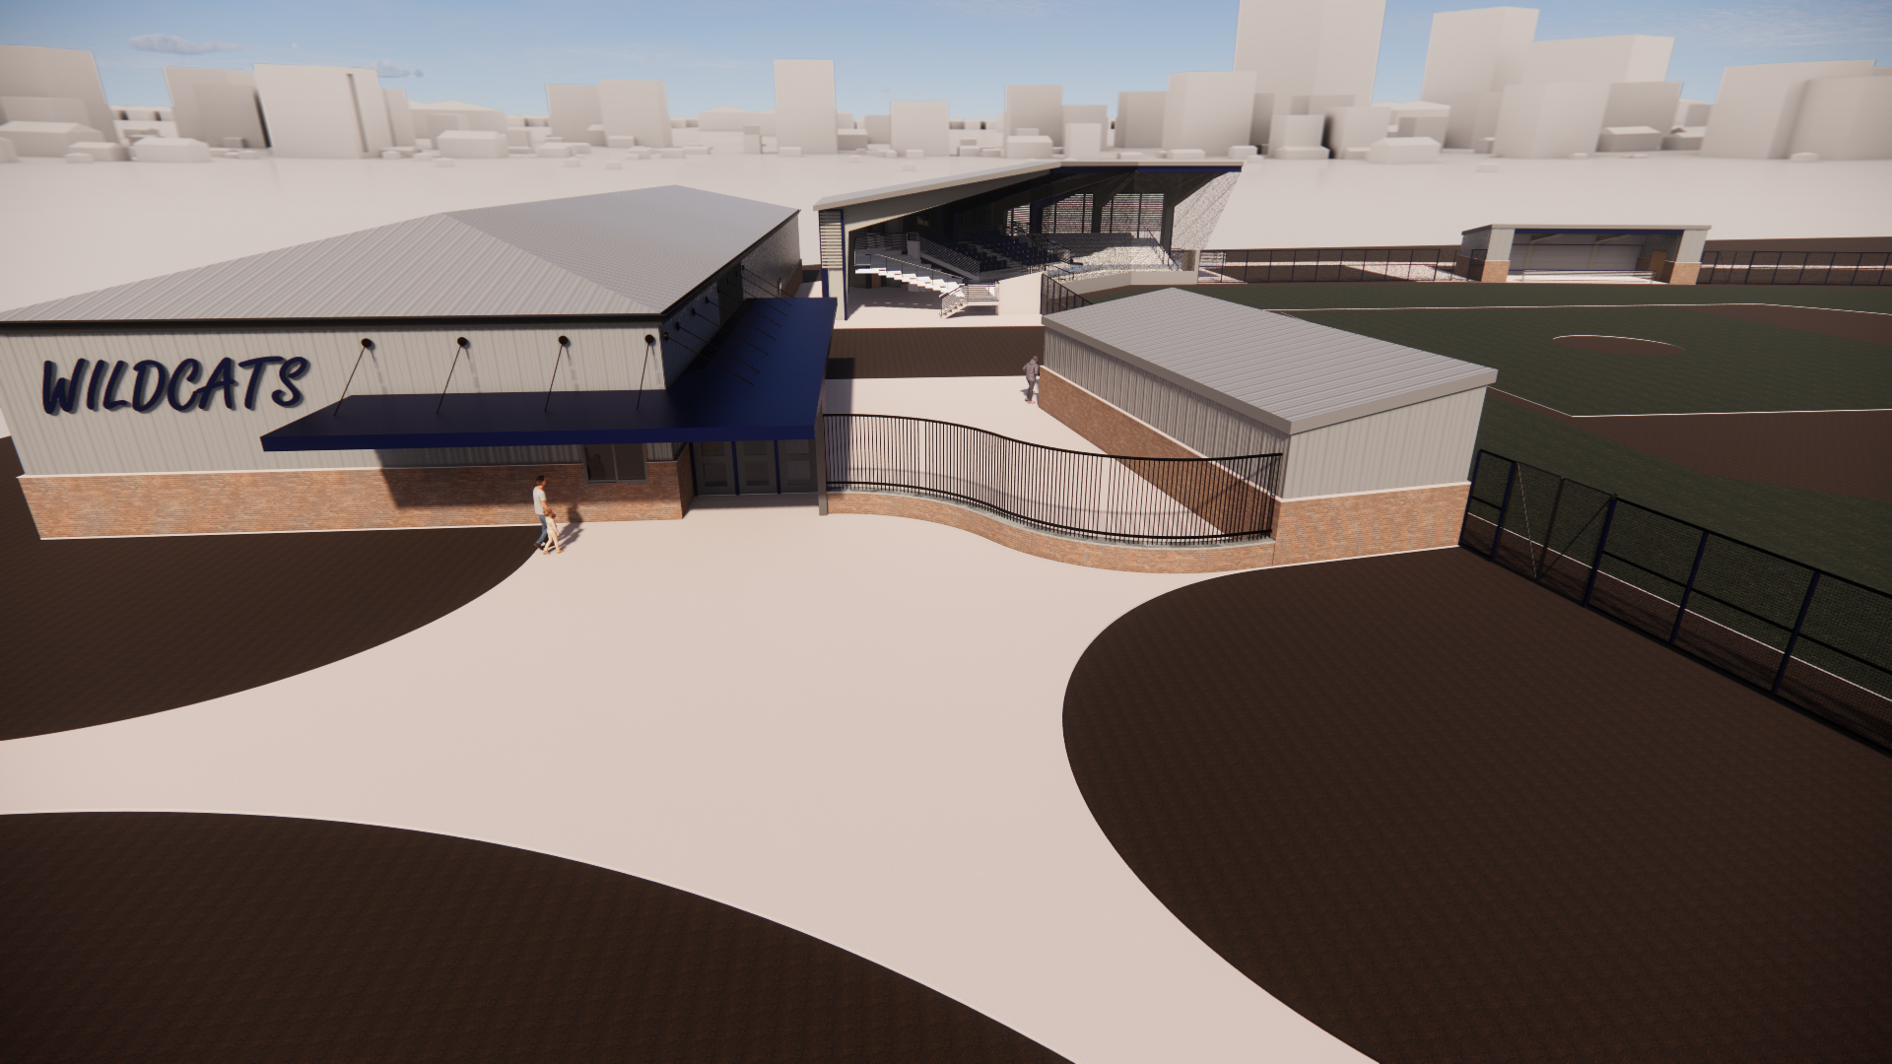
Meridian Baseball/Softballs
Milestones
Advertisement: 3/16/23
Bid Date: 4/13/23

Slide 3
Meridian Senior High School
Fine Arts
Admin

Slide 4
MHS New Administration

Slide 5
New Sidewalks & Canopies
Floor Plan

Slide 6
MHS Fine Arts
New Band Hall Extension w Storage
Alumni Platform
New Field Access from Band Hall

Slide 7
Band Hall Extension
Section Through Fine Arts

Slide 8
Magnolia Middle School
Class
Expanded Cafe
Library
Gym
New Ceilings
Admin
Aud.
Fine Arts

Slide 9
Magnolia Middle School

Slide 10
MMS Administration

Slide 11
Northwest Middle School

Slide 12
Northwest Middle School

Slide 13
NMS Administration

Slide 14
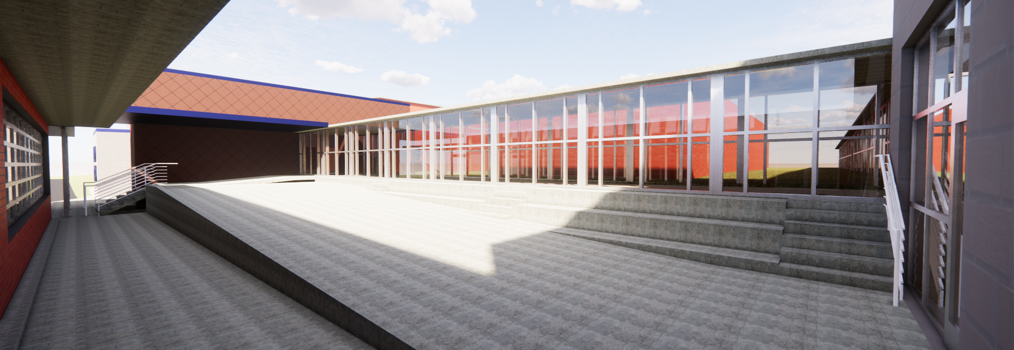
NMS Gym Entry & Exterior Class

Slide 15
NMS New Class & Fine Arts

Slide 16
NMS Cafeterias Expansions

Slide 17
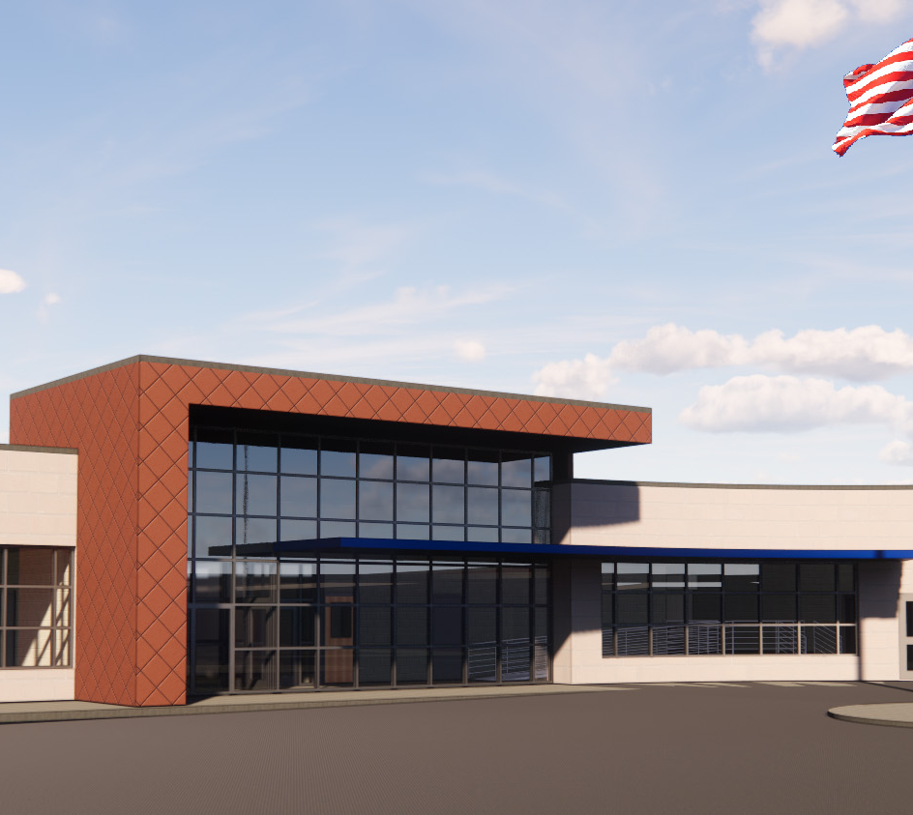
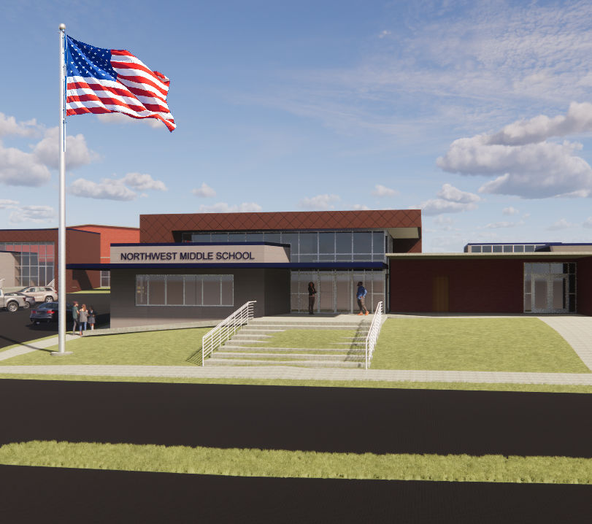
Meridian Public SD Bond Issue
Meridian HS
Athletics
Magnolia Middle
Northwest Middle

